Slide 1
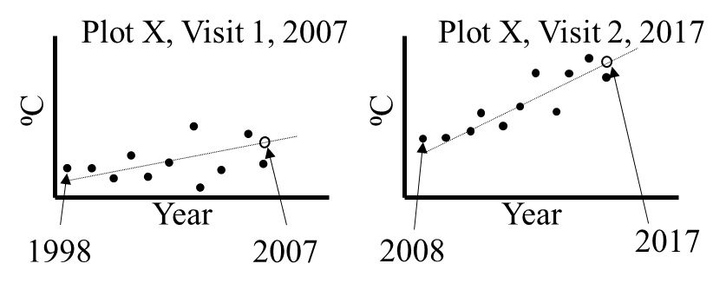
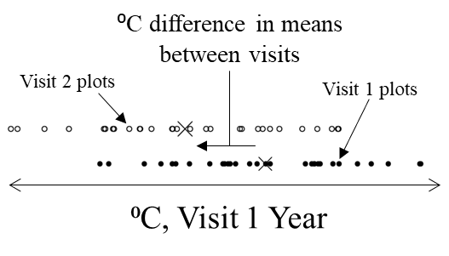
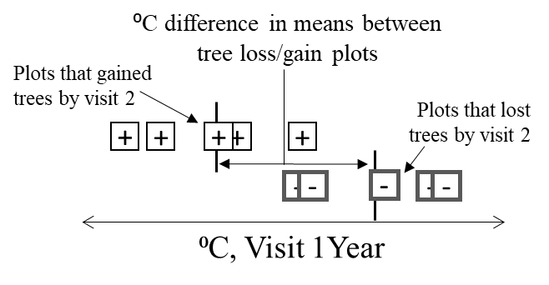
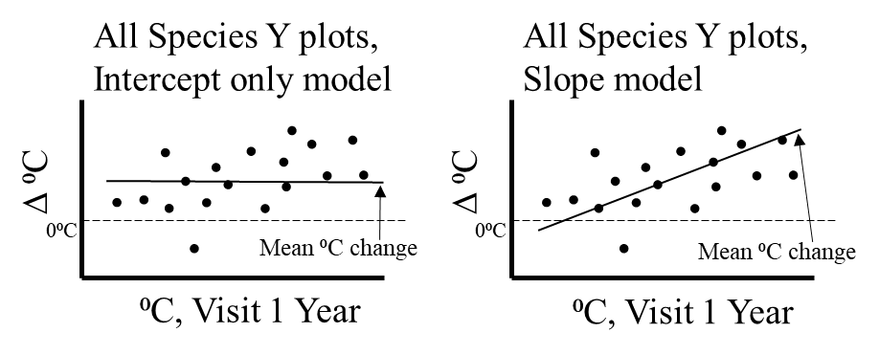
A. Predict temperature or precipitation values (open circles) for visits 1 and 2 at all FIA plots. Figure to the right depicts the predictions of temperature at a single hypothetical FIA plot (Plot X).
B. Conduct range shift analysis for species of interest. Range shift = mean of temperature or precipitation values for the population of plots occupied in visit 2 – those occupied in visit 1.
C. Conduct density shift analysis for species of interest, use only FIA plots at which a species either lost or gained individuals between visits. Density shift = mean of temperature/precipitation values for plots that gained trees – those that lost trees.
D. Using all FIA plots occupied by a species at either visit and the predicted temperature or precipitation values for visit 1 and visit 2, examine changes in plot temperature or precipitation (visit 2 – visit 1) across plots. Determine if an intercept-only or slope model better fit the data.
Figure 2. Analysis steps. A: Temperature and precipitation values were predicted for the visit 1 and 2 years for all analysis plots. B: The range shift analysis examined a species’ difference in mean temperature or precipitation between plots occupied during visits 1 and 2. C: The density shift analysis finds mean temperature and precipitation differences between a species’ plots that gained and lost individuals. D: For each species we examined how plot temperature and precipitation values changed between the two visits and related to visit 1 values. Note that for steps B, C, and D, plot x axes use temperature or precipitation values from the visit 1 year (see text for explanation). Graphical examples are for temperature.

